Slide 1

Control of Longitudinal Cracking in Prestressed Concrete Cylinder Piles
Dan Brown, P.E., Ph.D.
STGEC, 2016
Biloxi, MS

Slide 2
Outline
The Hathaway Bridge Problem
Cracking Mechanisms
Stress and strain due to pile driving
Design of Spiral Reinforcement
Internal pressure mechanisms
Summary

Slide 3
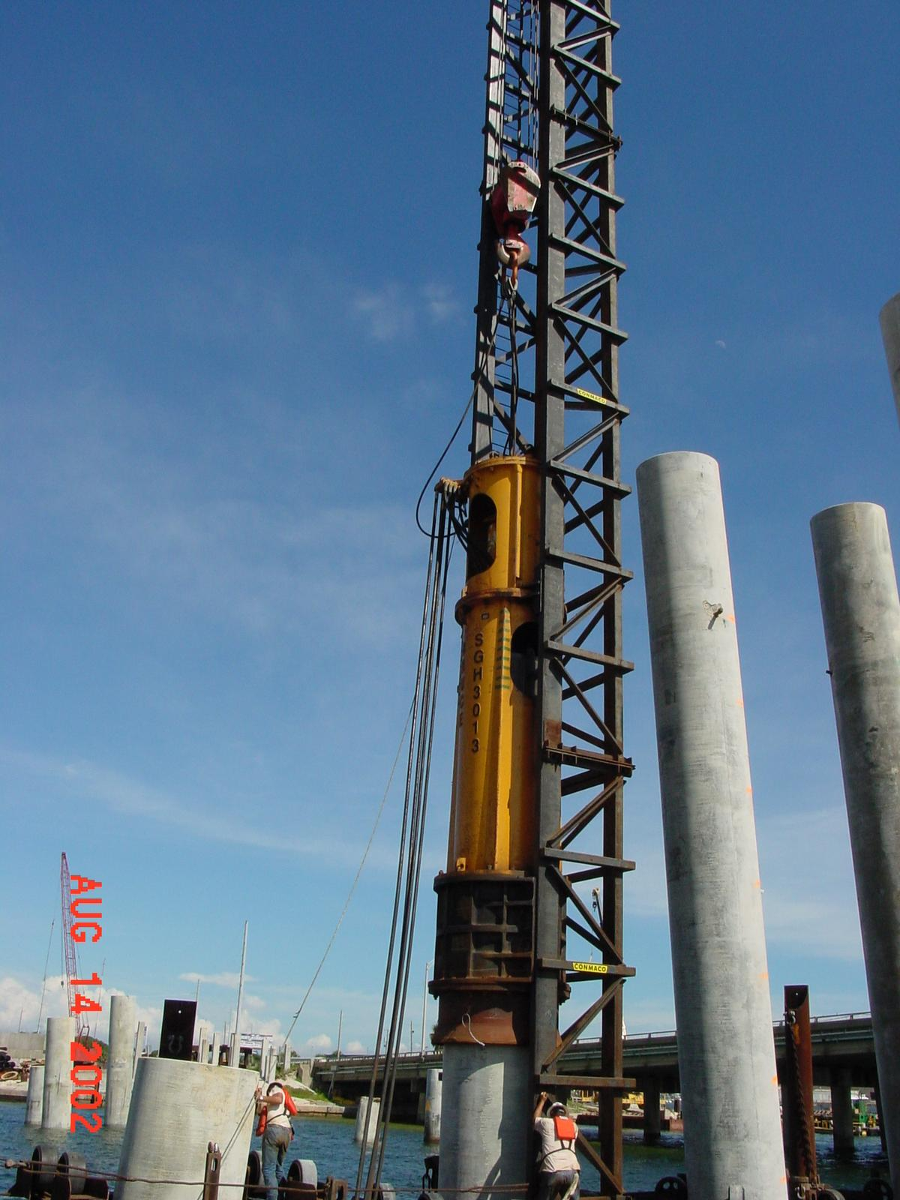
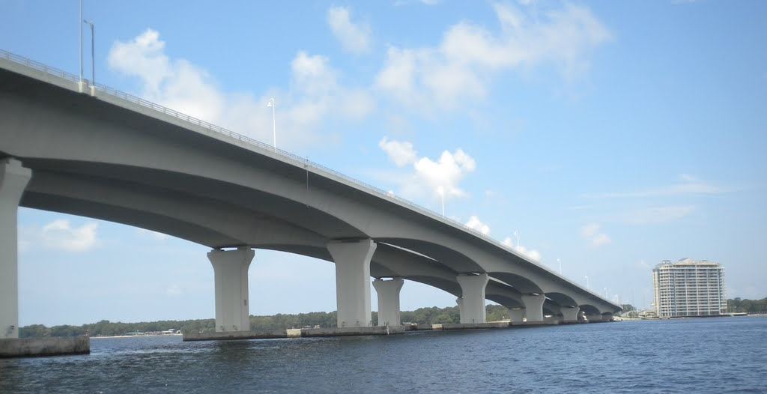
The Hathaway Bridge, Panama City, FL
Founded on 60” dia, 7.5” wall
Completed in 2003

Slide 4
Longitudinal Cracking
Post-construction underwater inspection in 2005
20 piles found to have longitudinal cracks
Cracks at mudline, extending upward by 5 to 25ft

Slide 5
Longitudinal Cracking
No reported overstressing, or significantly different behavior from uncracked piles
15 of the cracked piles were here

Slide 6
Other Reports of Longitudinal Cracking
Gerwick, 1968 (PCI Journal)
Avent and Mukai, 1998 (LTRC) – Lake Ponchartrain
Kemp and Muchard, 2007 (ASCE GSP 158) – Florida
Rauche and Webster, 2007 (ASCE GSP 158)
Liu, 2008 (Stress Wave conference, Portugal)

Slide 7
Longitudinal Cracking Mechanisms
Poisson effect due to uniaxial compression
Internal pressure
  Air or water
  Soil plug inside

Slide 8
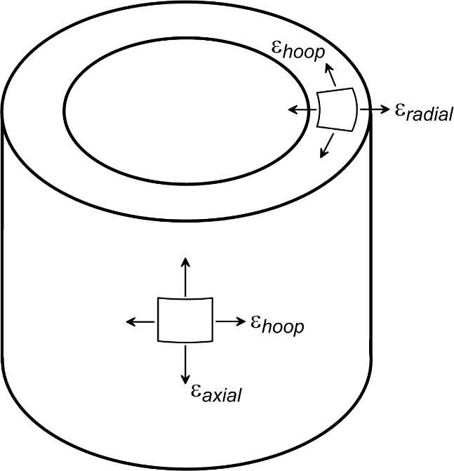
Longitudinal Cracking Mechanisms
Poisson effect
  Axial compression causes lateral expansion
  Not unique to cylinder piles – e.g. splitting tensile strength tests

Slide 9
Tensile Strength and Modulus of Concrete
ACI Committee 363R “State-of-the-Art Report on High-Strength Concrete” (1992):
= 620psi for 7ksi concrete
= 4570ksi for 7ksi concrete

Slide 10

Strain at Tensile Splitting ($ε_{ts}$)
Hooke’s Law:
$$ε_{ts}={f_{t}}/{E_{c}=\left({620}/{4,570,000}\right)x100\%=0.0136\%}$$

Slide 11

Dynamic Modulus
Based on wave speed and mass density:
    $$E_{c}=V_{s}^{2}ρ$$
Dynamic measurements indicated V_{s} ≈ 13,400fps,
Corresponding E_{c} = 5800ksi, about 10% higher than static modulus (5230ksi avg)

Slide 12

Maximum Allowable Compressive Stress ($s_{apc}$)
per FDOT 455 spec: $s_{apc}=0.7f_{c}^{′}−0.75f_{pe}$
      ($f_{pe}$ is the effective prestress = 80% of 1280psi)
For Hathaway: $s_{apc}=$ 4.1ksi based on design $f_{c}^{′}$ (7ksi)
  Driving stress during installation = 3.5 to 4ksi
  Ok per spec, especially since actual $f_{c}^{′}$ ≥ 8.5ksi

Slide 13

Strains During Driving
Max compr stress during driving ≈ 4ksi
Compr stress due to prestress ≈ 0.9ksi
        (allowing for add’l reduction in prestress due to 4ksi compr)
$$ε_{axial}=\frac{σ}{E_{c}}≈\frac{4.9ksi}{5,800ksi}≈0.00085$$
Note: E_{c} based on measured dynamic modulus

Slide 14
Estimated Hoop (Tensile) Strain
Poisson’s ratio for concrete ≈ 0.2
$$ε_{hoop}=−ν∙ε_{axial}≈−0.20∙0.00085≈−0.000169=−0.017\%$$
> 0.014% !

Slide 15
Conclusion:
Even using:
  higher than design “as-built” strength and modulus, and
  “allowable” compressive stress per FDOT 455,
tensile strains are sufficient to produce longitudinal cracking in the concrete during driving

Slide 16
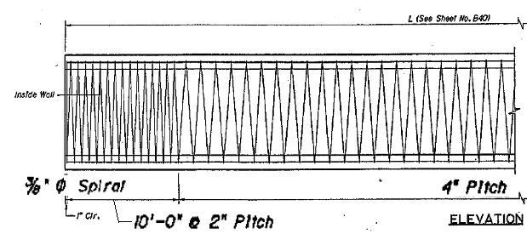
Reinforcement for hoop strains
Cracking not found here
Cracking found in this region
Reinforcement used on Hathaway, and consistent with FDOT standards

Slide 17
Reinforcement
PCI guidelines (1993)*:
“… for hollow-core piles whose upper portions are exposed in water or air, the spiral reinforcement at yield should be adequate to develop the splitting tensile strength of the concrete. This will generally require a spiral area of between 0.6 and 1.0 percent”
Area of spiral
=0.37%
O.D. – I.D.
Spiral pitch
*Portland Cement Institute (PCI) (1993). Recommended practice for design, manufacture, and installation of prestressed concrete piling. PCI Committee on Prestressed Concrete Piling, printed in PCI Journal, March-April 1993, 28p.

Slide 18
What happens when concrete cracks?
Tensile stress transfers from concrete to spiral reinforcement:
tributary area of concrete, A_{c} = 7.5”x4” – A_{sp} = 29.9 in²
Force in concrete at time of cracking
= f_{t} x A_{c} = 18.5k (design) to 21.9k (avg as-built)
Yield strength of a 3/8 inch spiral is no more than 8.3k,
even assuming 75ksi failure (ultimate) tensile stress
Conclusion: reinforcement is inadequate and will fail when concrete cracks

Slide 19
FLAC^{3D} Model
Dynamic load input from wave equation analysis (GRLWEAP)
Used to assess:
  Whether tensile strength limit may have been exceeded
  Whether inertia and damping may have influenced behavior relative to static analysis
Conclusion: results were not significantly different from the static analyses described previously

Slide 20
Internal Pressure Mechanism
Consider potential radial stress due to internal pressure
For piles at Hathaway:
  piles were typically in 20ft or more water and were jetted for a significant portion of the length,
  piles included vents located at 10ft and 20ft below the top
  no significant buildup of soil or fluid within the interior of any of the cracked piles during pile driving.
  no soil was removed from the interior of the pile in order to cast the reinforced concrete connection detail

Slide 21
Hydrodynamic Internal Pressure
Even with vent holes, hydrodynamic pressures can occur if the pile is driven underwater and there is no cushion of air
Some piles were driven slightly into the water, depending on tidal fluctuation at end of driving
Figure from Rausche and Webster, 2007

Slide 22
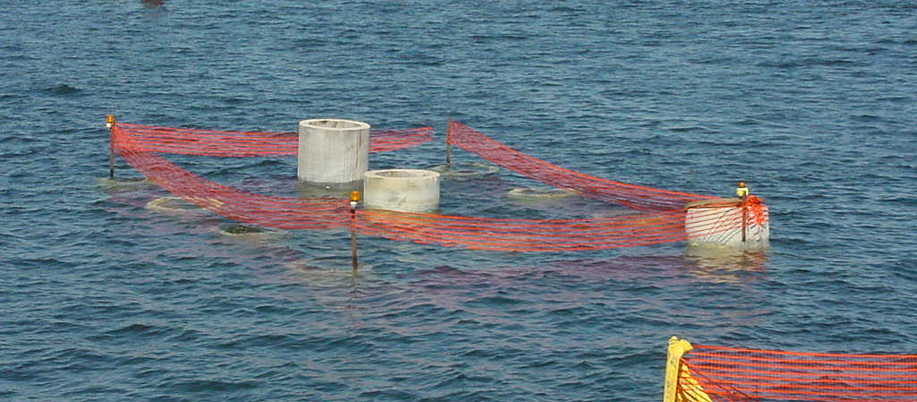
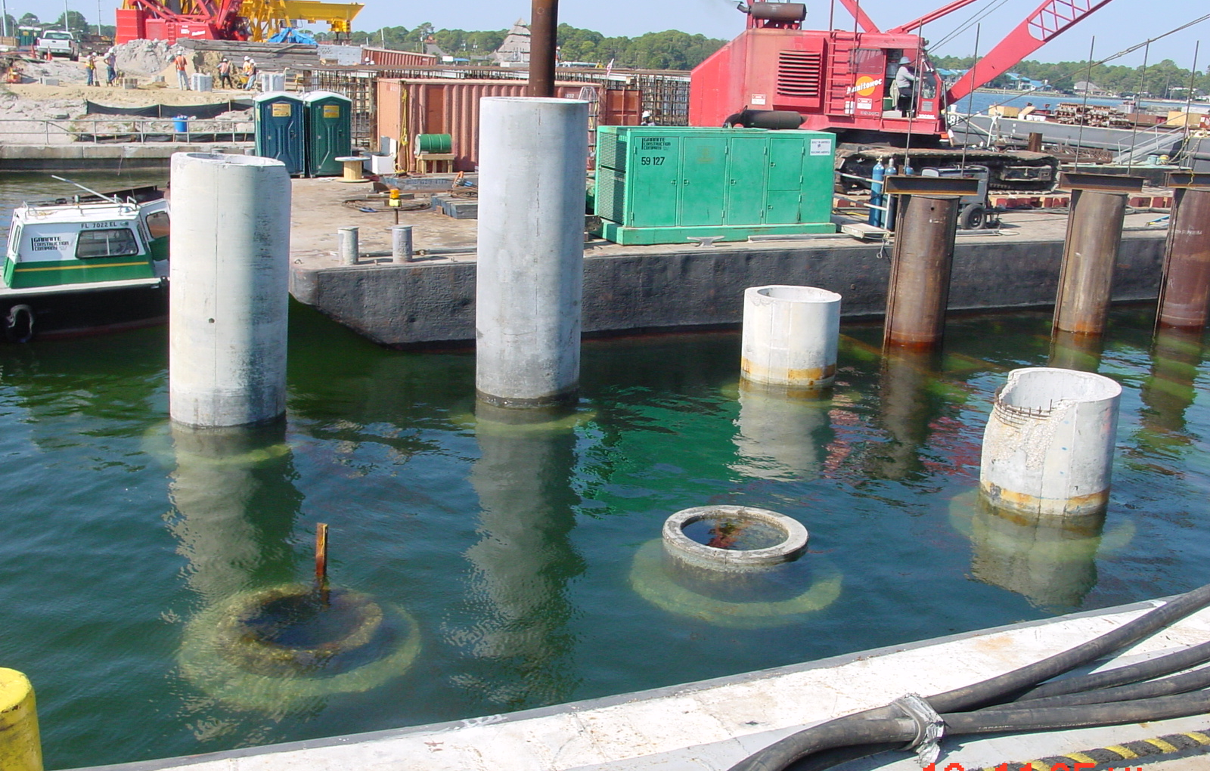
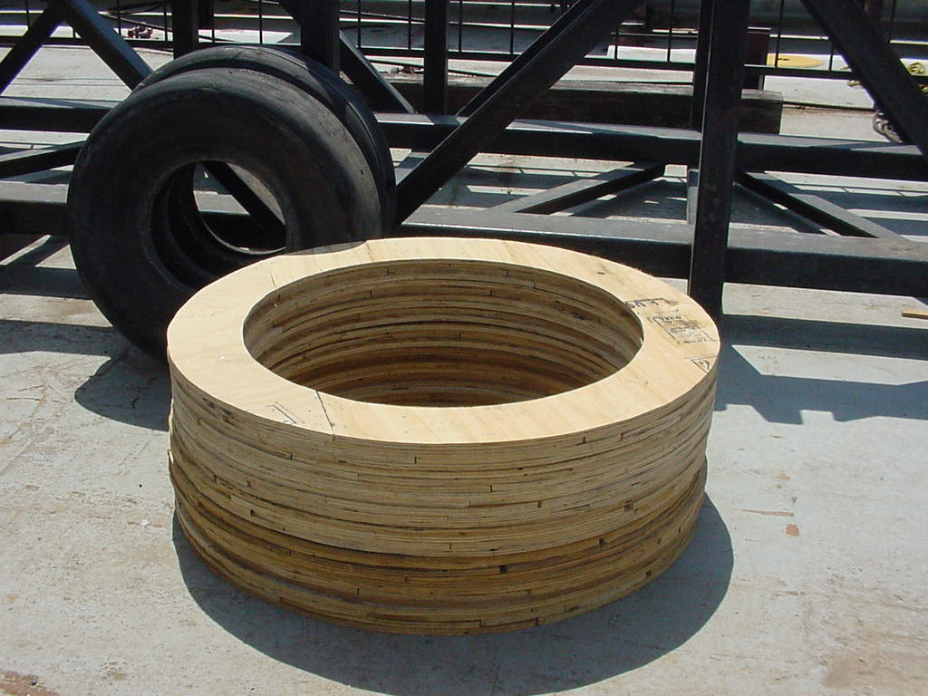
Photos after Driving and Removal of Template

Slide 23

Hydrodynamic Pressure in the Water Column
$$p_{w}=v_{m}c_{w}ρ_{w}$$
v_{m} = maximum particle velocity (closely related to the maximum particle velocity of the pile at the time of ram impact),
c_{w} = wave speed in water (1500m/s or about 4900ft/s)
ρ_{w} = mass density of water (1000kg/m³)
For the piles at Hathaway, the maximum potential hydrodynamic pressure can be estimated at about 550psi

Slide 24


Tensile Stress due to Hydrodynamic Pressure
Hoop stress, σ₂
$$σ_{2}={Rp_{w}}/t$$
R = interior radius of the pile,
p_{w} = hydrodynamic pressure,
t = pile wall thickness
σ₂
For a hydrodynamic pressure of 550psi, the maximum computed hoop stress, σ₂ = 1650psi, far in excess of the tensile strength (around 700psi)
Note that 1650psi is probably an upper bound, since it is unlikely that no air would be present for a pile driven barely into the water
$$p_{w}$$

Slide 25
Possible Factors Affecting Cracking
Variation in material strength
  Of the concrete (age?; strain rate effect?)
  Of the spiral (specified strength is minimum)
Variation in soil conditions, and condition of cushion
Number of blows at high stress levels
Variation in pile top relative to water level
Hoop stress concentration at “seam” in the casing form

Slide 26
Conclusions
We need to pay attention to hoop stress
  Limit max compressive stress
  Increase transverse reinforcement
  Avoid underwater driving
FDOT may wish to reconsider standard cylinder pile detail and/or 455 spec control on compression

Slide 27
Current FDOT Standard
Note: I could not locate standard drawings for these piles from other DOT websites

